Slide 2

.NET, IoT and Hedgehogs!
Mike Irving
dotnetsheff – 1st August 2023
@mikeirvingweb

Slide 3
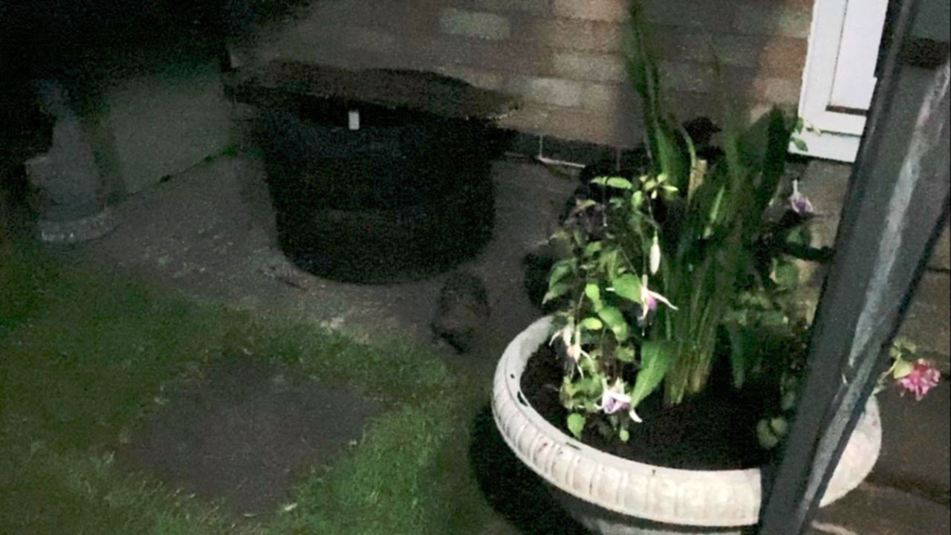
Setting the scene
July 2022,
temperature nearly 40° 🌞
Sat relaxing in the garden at night
Scurrying sounds heard
Hedgehog spotted, and filmed (badly)

Slide 4
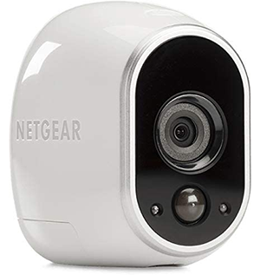

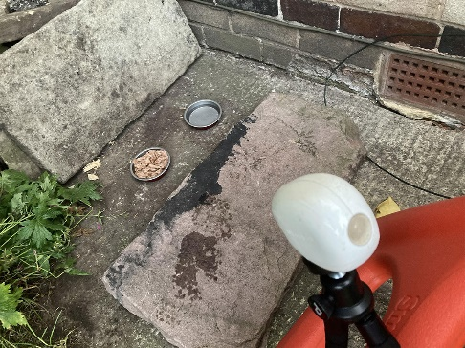
What to do?
Make use of one of our Arlo security cameras - see what footage it might capture
Acquire some Hedgehog food - Spike’s Hedgehog Food ‘Scrummy Meaty Supper’
Setup a monitoring area - Camera - Food - Water

Slide 5
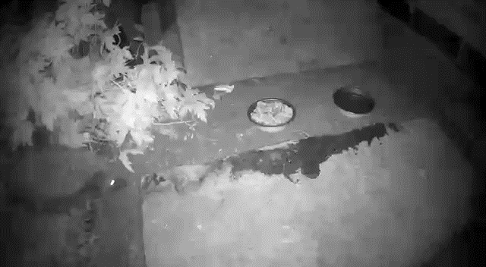
The first footage

Slide 6
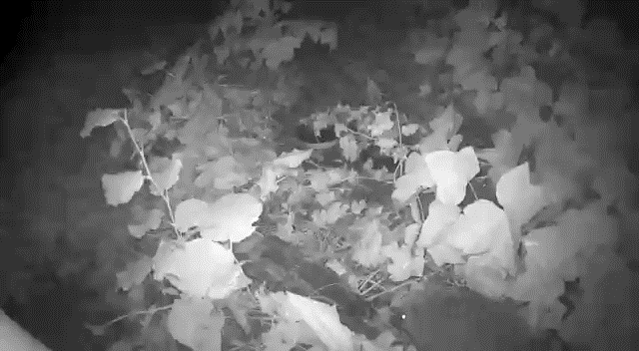
Discouraging cats!

Slide 7
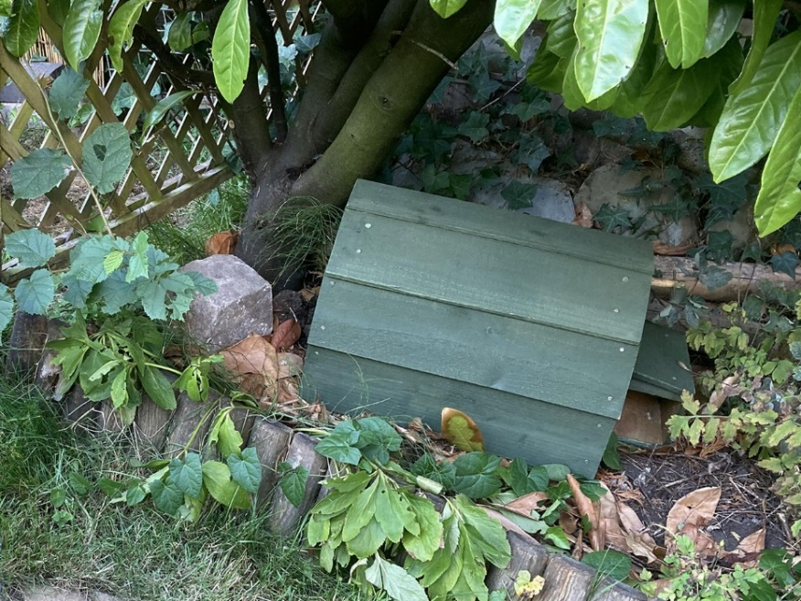
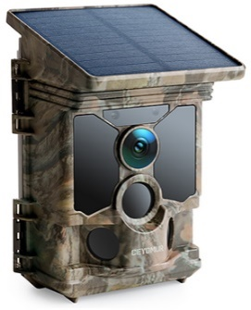
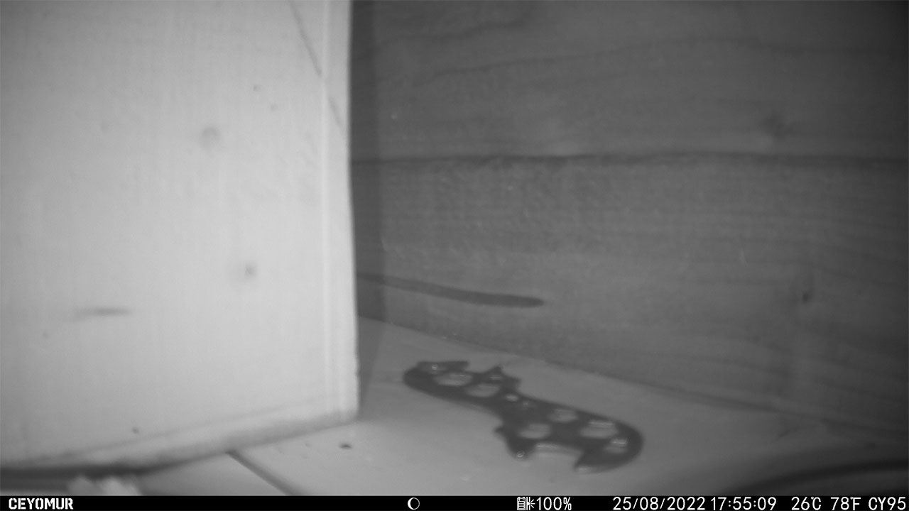
A better setup
Bought a ‘Hedgehog House’ - set it up in the garden
Installed a new ‘Field Camera’ inside - Ceyomur CY95
Put food and water bowls inside
A long wait
after a few days mice came, then hedgehogs!

Slide 8
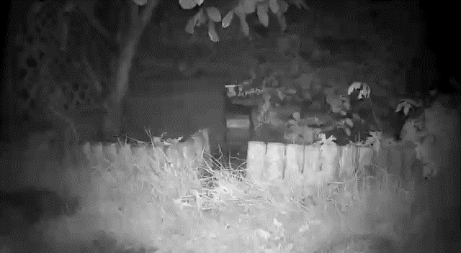
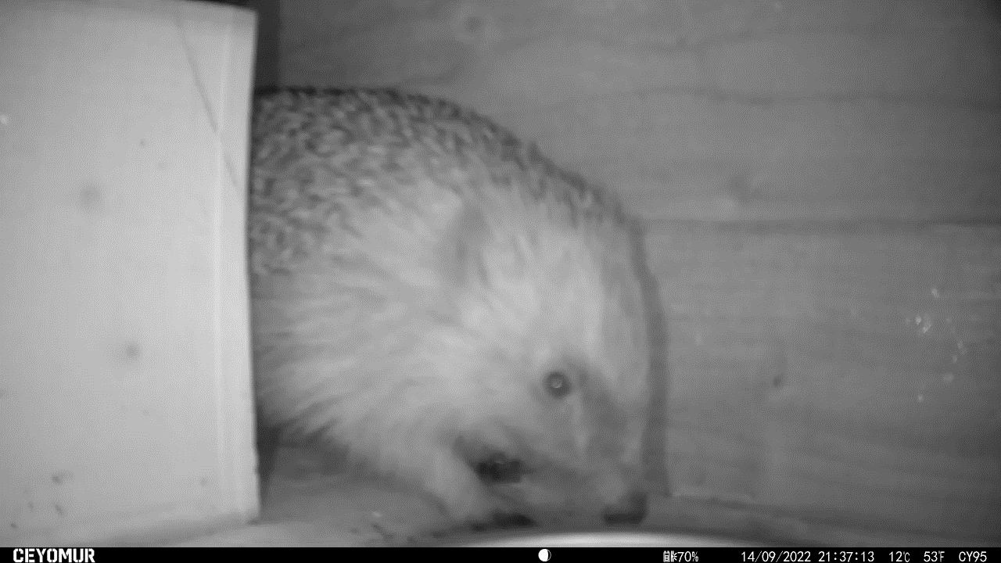
The first ‘house’ guest

Slide 9

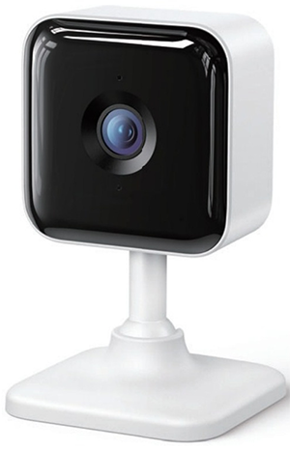
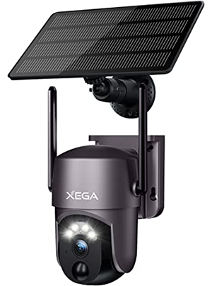
Experimentation
Soon hedgehogs were coming regularly
But the food was messy, and often wasted
Changed to a new favourite – Go Cat!
New cameras acquired - Xbro XC100 and Xega RBX-S50
- Xbro put inside the house, Ceyomur moved outdoors

Slide 10
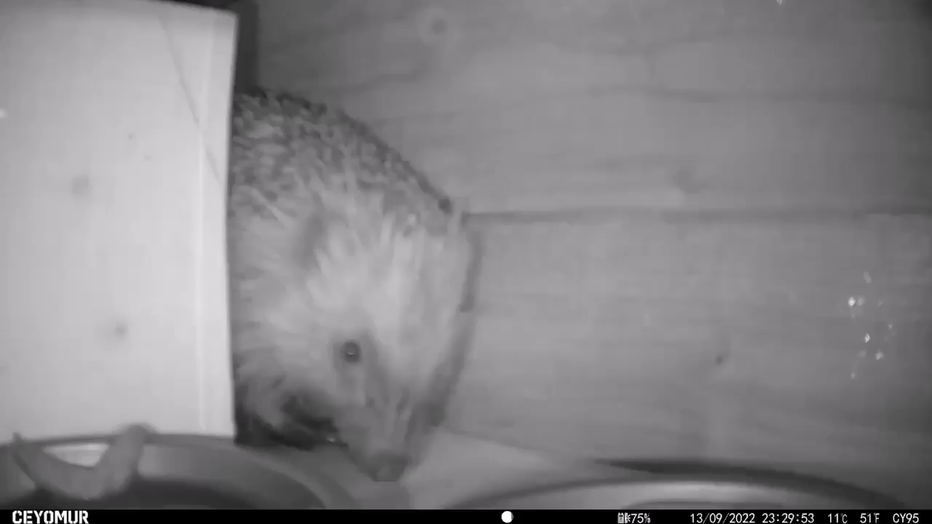
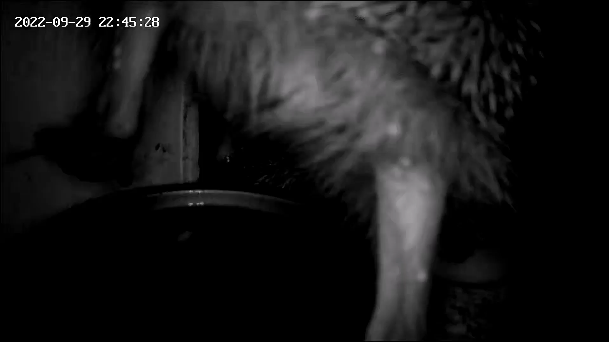
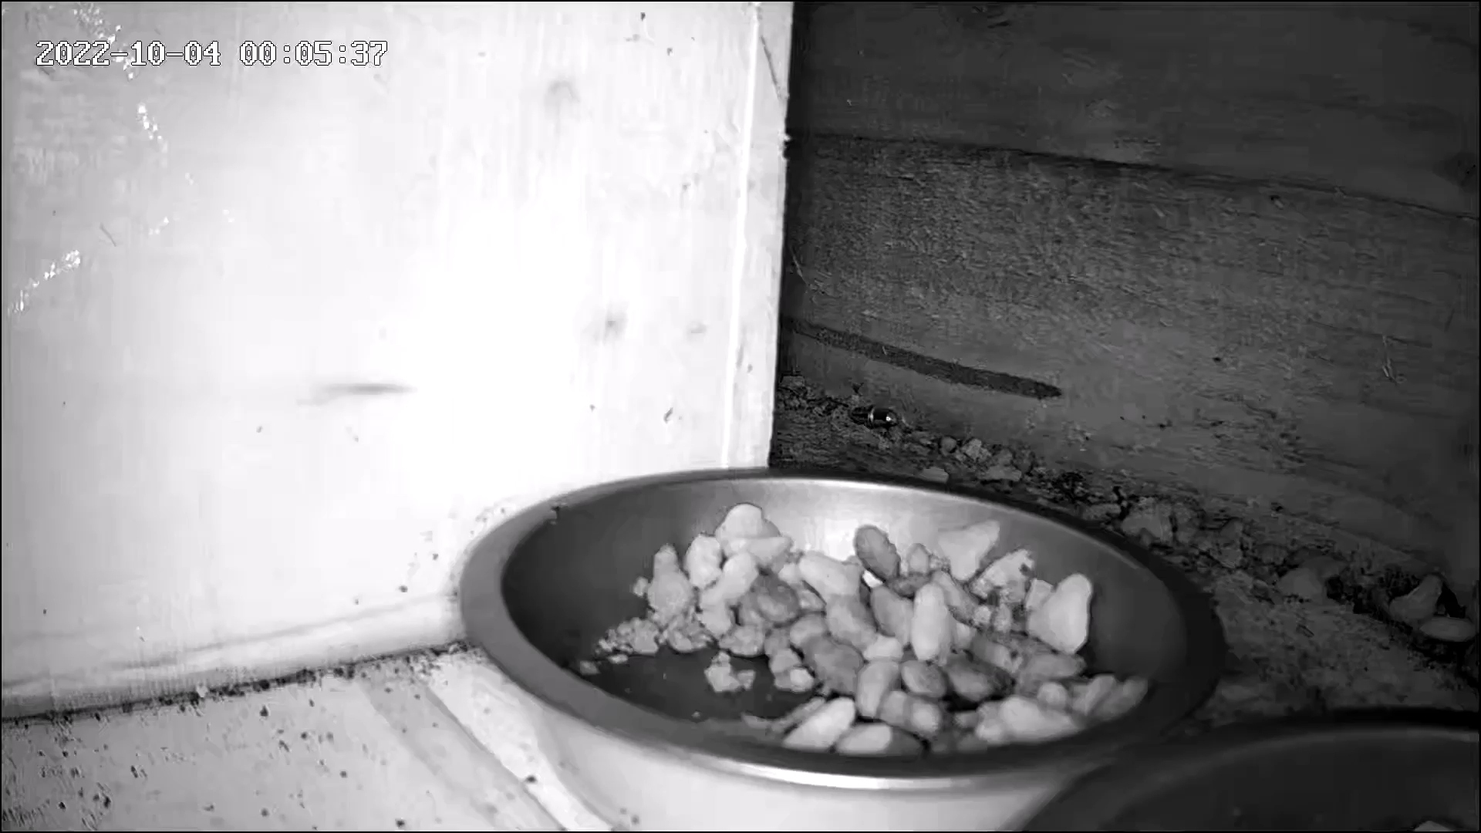
Magic moments
Scoffing
Excuse me
Yoink!

Slide 11
Problems – can I program this?
Had begun getting time consuming:
4 cameras, all with different mobile apps
Collecting SD Cards, moving files off them
Examining the contents of files – many false alarms
Charging batteries
Storage space

Slide 12

Camera tech comparison
 | Arlo HD | Ceyomur CY95 | Xbro XC100 | Xega RBX-S50
App: | Arlo Secure | Game Camera Pro | Osaio | UBox
Records to: | Cloud or Base Station | Micro SD Card | Cloud or Micro SD Card | Cloud or Micro SD Card
Connectivity: | App only / proprietary | Own Wi-Fi, via app | Local Wi-Fi, via app | Local Wi-Fi, via app
Power: | CR123 Batteries | Solar, Lithium or AA | USB power required | Solar, Lithium

Slide 13
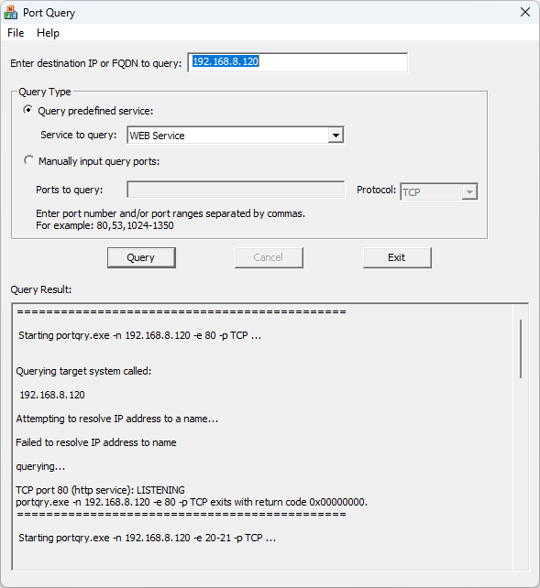
Local Wi-Fi cameras
Xbro XC100 and Xega RBX-S50
Can I connect, via any method?
- HTTP / Web, FTP, SSH etc
Lookup likely ports on Internet,
Use tools to discover open ports - Microsoft ‘Port Query’ - PortQry CLI, or PortQryUI
Failed to gain access 🤨

Slide 14
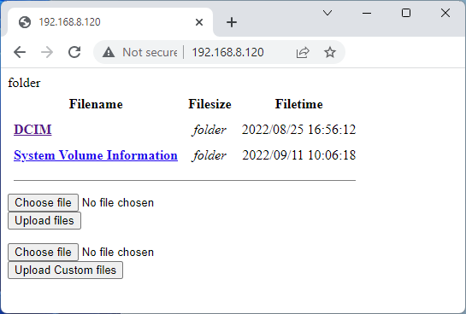
Private Wi-Fi camera
Ceyomur CY95 ‘Field Camera’
App uses Bluetooth LE to enable Wi-Fi
Once enabled, Mobile App can connect
Web interface on Port 80 🙂
Started new project ‘Camera Experiments’

Slide 15
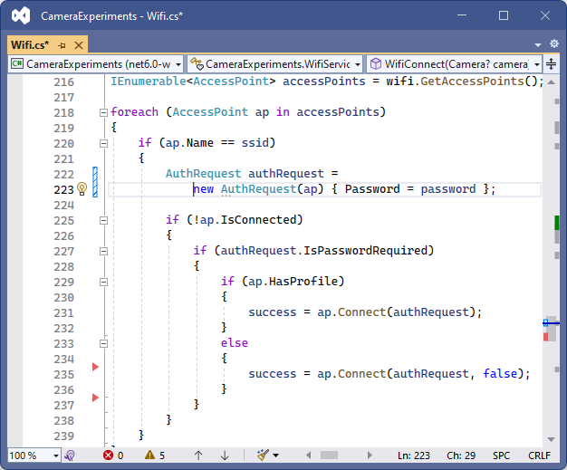
Experiments – Wi-Fi
Use the App to enable Wi-Fi (via Bluetooth) - then connect via PC
C# Code to connect to Wi-Fi networks - uses SimpleWifi.netstandard NuGet package
Can scan and connect to camera Wi-Fi, - and switch back to local Wi-Fi
added retries, as temperamental

Slide 16
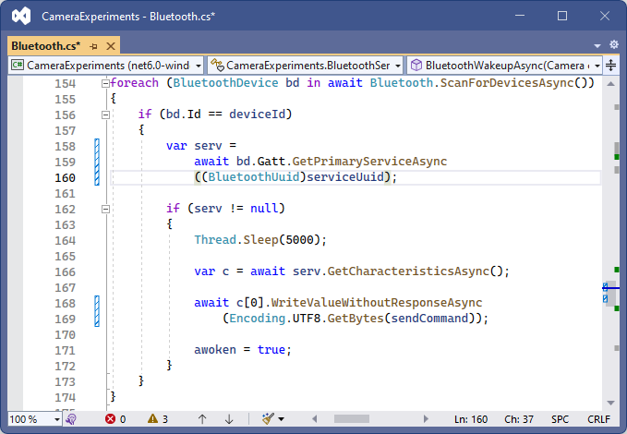
Experiments – BLE
Python code for Bluetooth on GitHub
Tried to achieve something similar with C# - Help from Peter Foot - twitter.com/PeterFoot
uses InTheHand.BluetoothLE NuGet package
Could successfully issue Bluetooth LE command, - activating the Wi-Fi network - so could then run the Wi-Fi connect code
delays and retries added

Slide 17
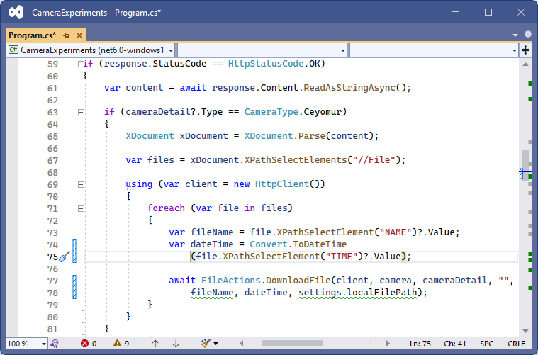
Experiments – Files
Found alternative URL for XML file list
Wrote code to parse the list, download then delete each file
Then set the correct date / time
Filename format yyyy-MM-dd-HH-mm-ss_Camera-Name_Filename.MP4

Slide 18
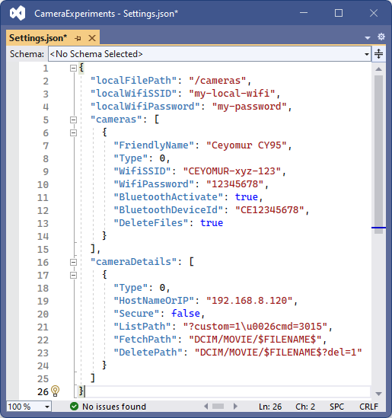
Defining cameras
Always the goal to connect all cameras
JSON to describe Settings - Cameras, Wi-Fi etc
Adjust code to do things in a generic way
Piece together into a program

Slide 19
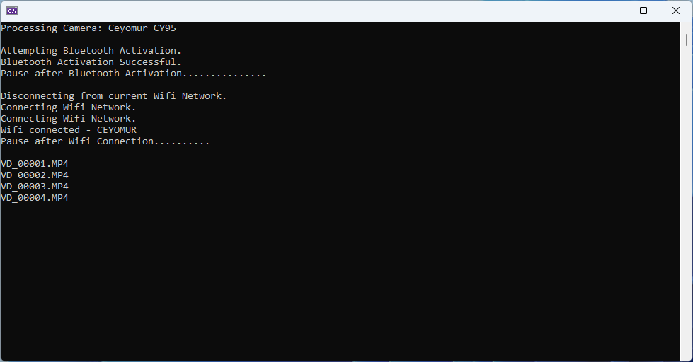
In action – Camera Experiments
https://github.com/mikeirvingweb/CameraExperiments

Slide 20
Files – lots of them
‘Macclesfield Hedgehogs’ website idea
Footage uploaded somewhere.. S3?
Automated, Approved or Unapproved footage
Generate list of files to be used by website?
Another new project ‘S3 Bucket Experiments’

Slide 21
S3 Bucket Experiments project
Started with AWS S3 Examples for .NET https://github.com/awsdocs/aws-doc-sdk-examples/tree/main/dotnetv3/S3
Functionality for Uploading, Moving (Copying then Deleting), Reading files for generation of JSON list
File structure created to process each camera, - automated, approved, unapproved files

Slide 22
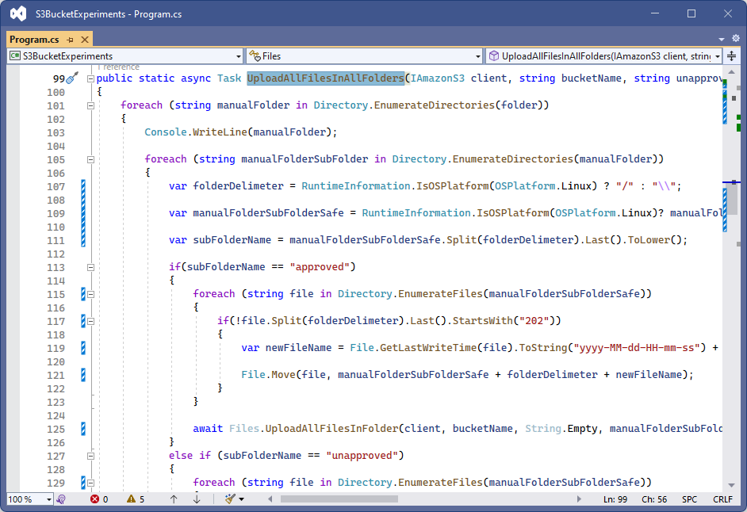
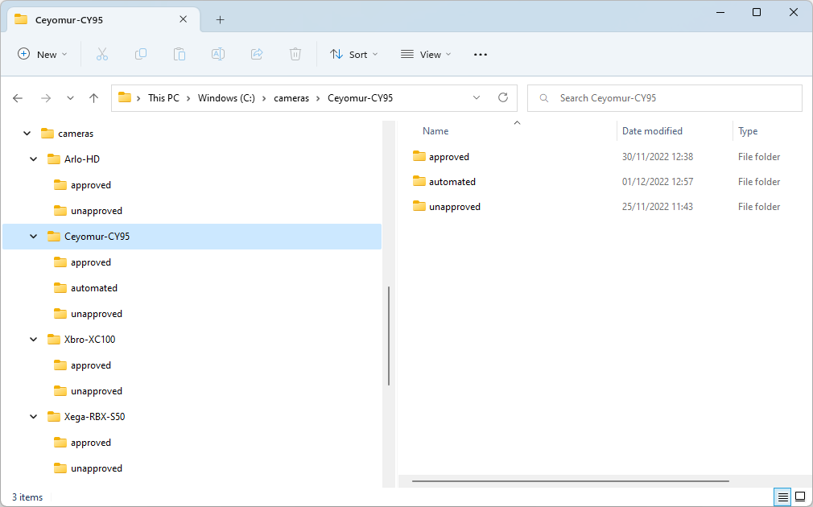
Structured folders

Slide 23
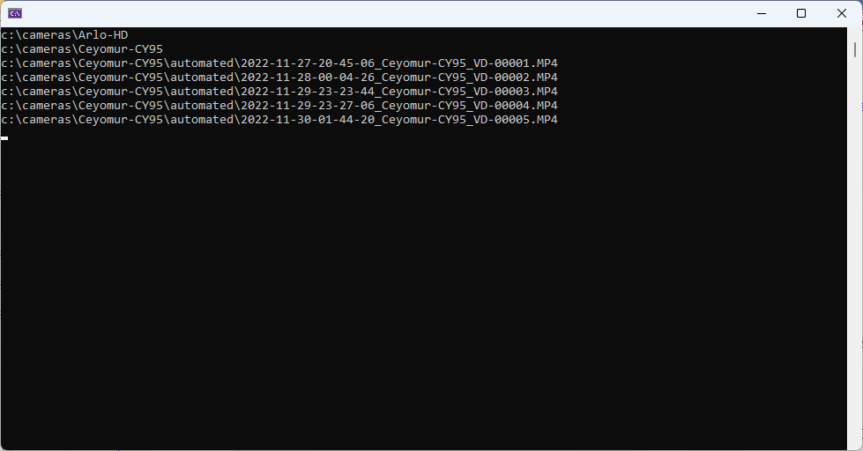
In action – S3 Bucket Experiments
https://github.com/mikeirvingweb/S3BucketExperiments

Slide 24
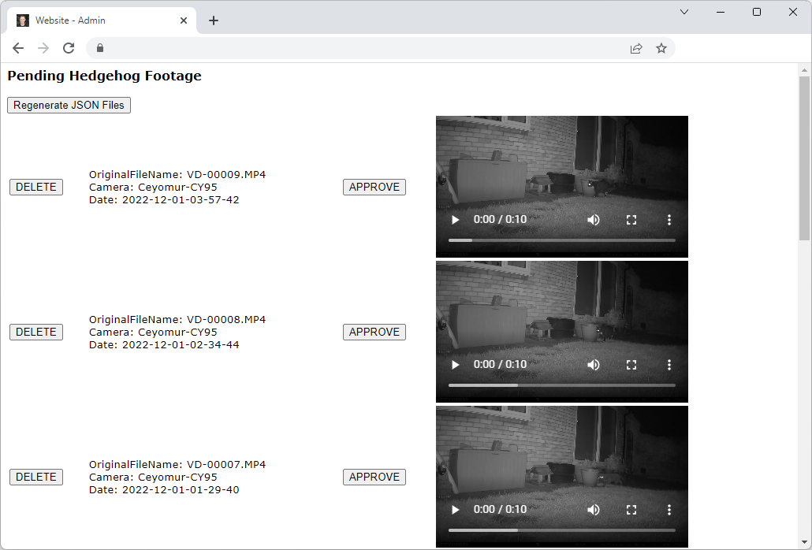
Footage approval web page
Private web page
Approve or Delete files that were ‘automated’ or ‘unapproved’
AWS Lambda Function
- code lifted from S3 Bucket Experiments
- Approve: Move files from Upload to Main
Regenerate JSON List for website

Slide 25
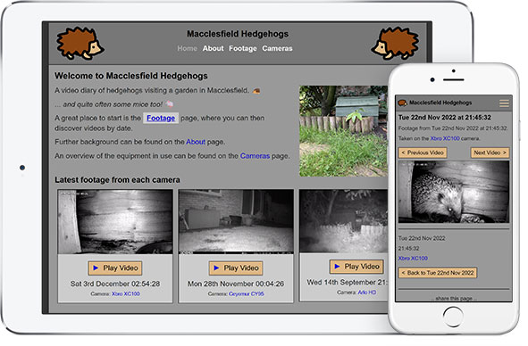
Website
Single Page Application - HTML / CSS / JavaScript
Makes use of Jekyll
Runs on GitHub Pages
Reads JSON Feed from S3
www.macclesfieldhedgehogs.co.uk

Slide 26
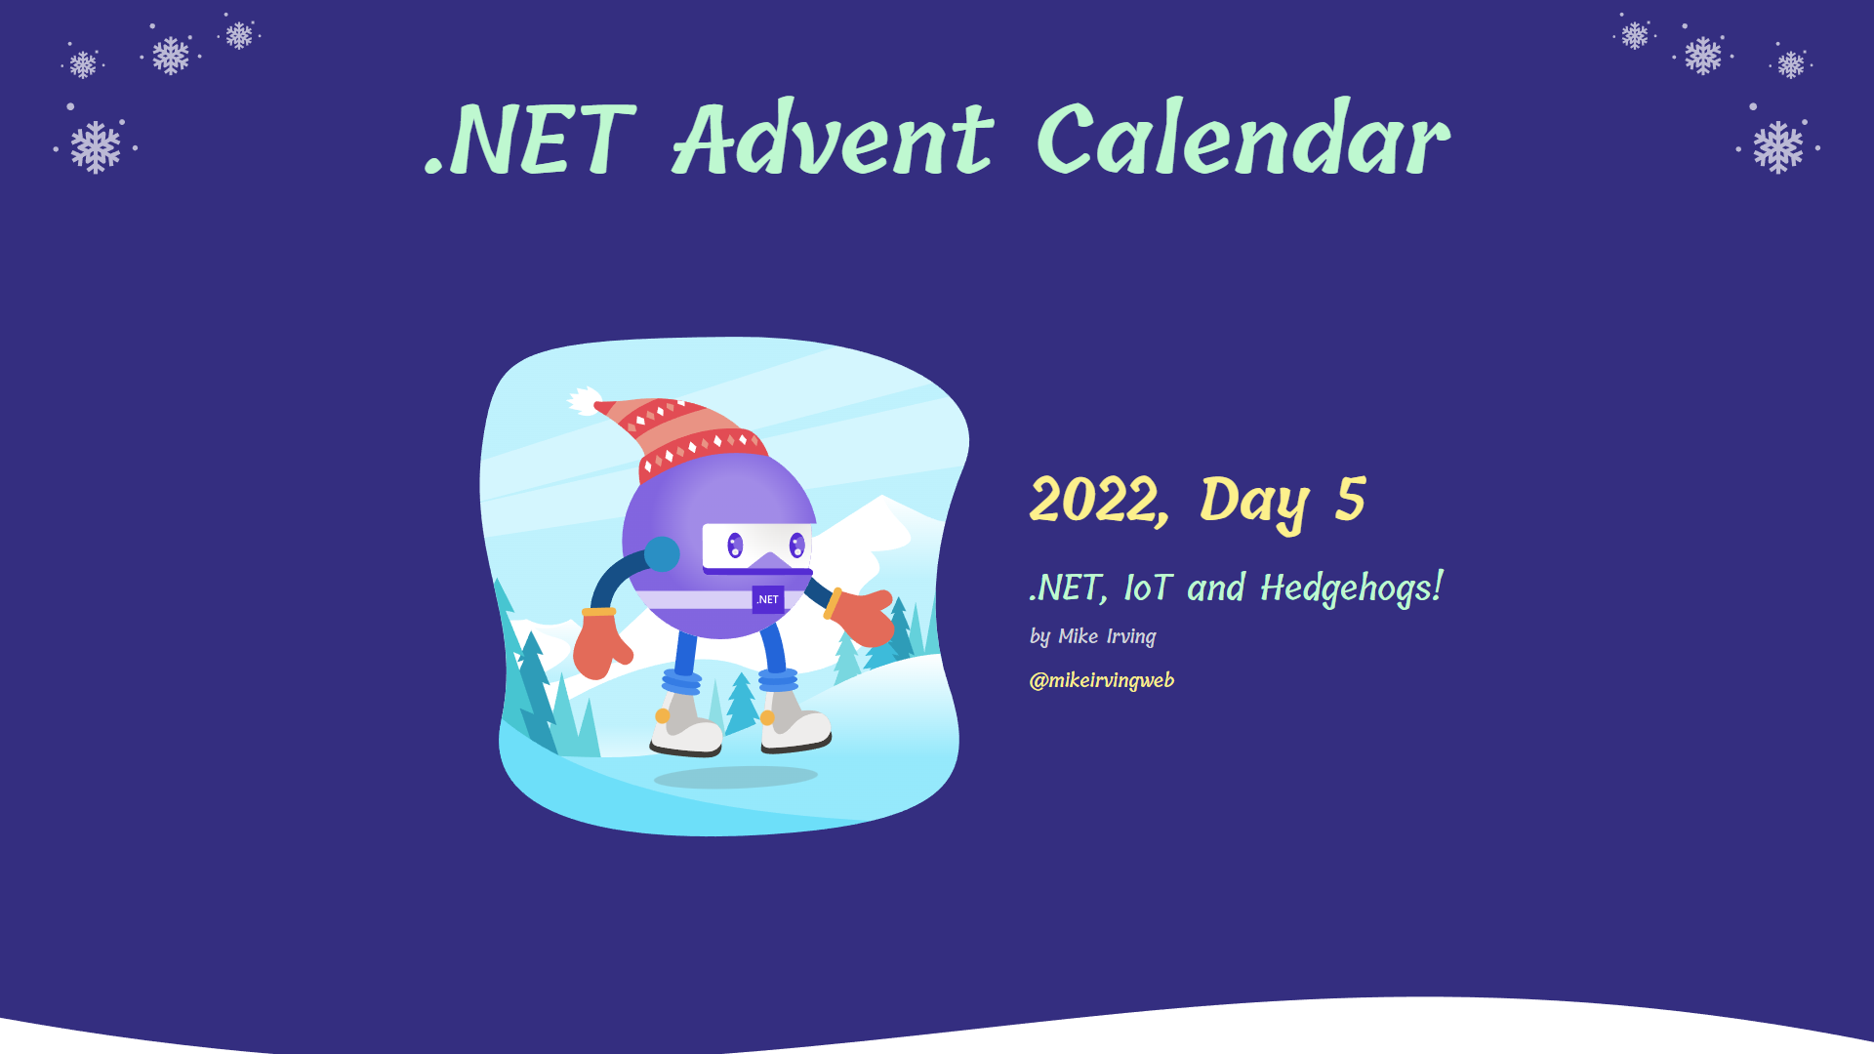
.NET Advent Calendar
https://dotnet.christmas/2022/5

Slide 27
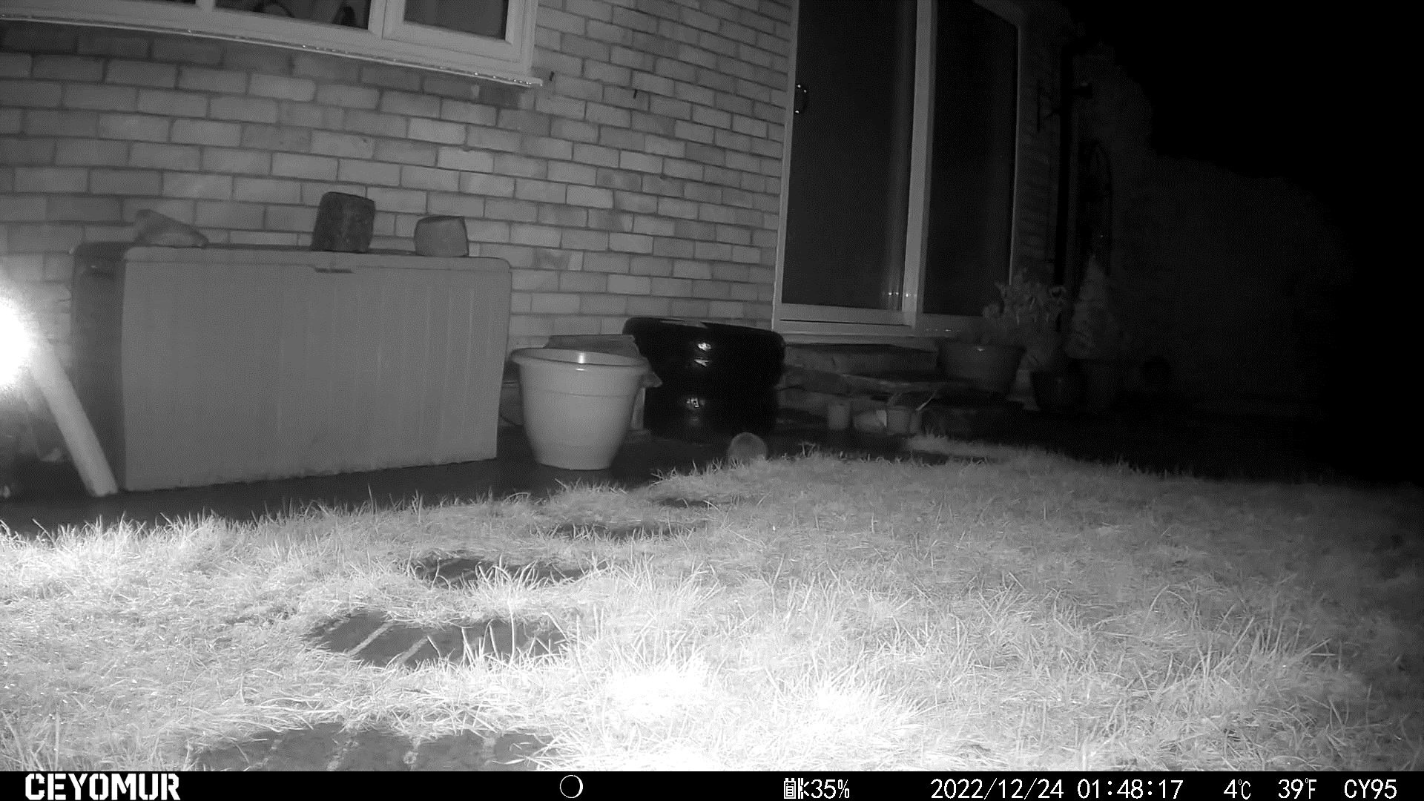
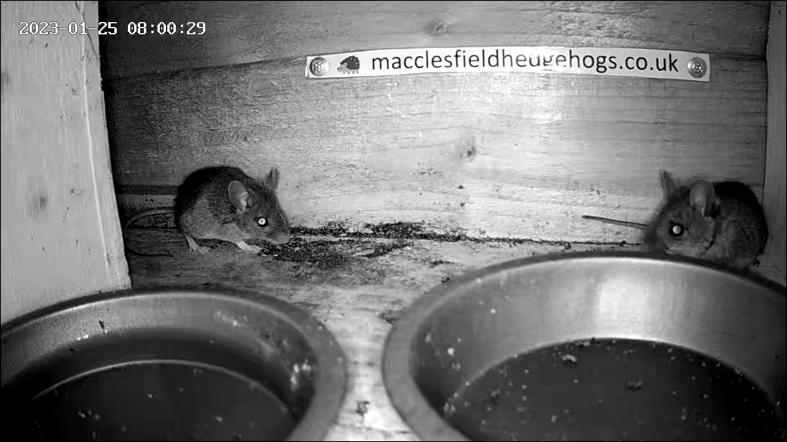
Hedgehogs hibernating

Slide 28
Post launch changes
Video thumbnails
Website alterations
Raspberry Pi
Linux
Automation
System alerts
.. and more! (the very latest developments)

Slide 29
Video thumbnails
Having no thumbs = problem 👎
Quick fix – show 5 at a time, with plus button [+]
Proper fix, supply a thumbnail ‘poster’ graphic (JPEG) <video poster="https://some-graphic.jpg"><source src="https://some-video.mp4"></video>
But how to create them?

Slide 30

Video thumbnails
Look on NuGet, most packages utilising FFmpeg
- decide upon Xabe.FFmpeg NuGet Package
Another AWS Lambda Function
- create a thumbnail image for any video file that does not have one
- put the images back into the S3 Bucket, and delete any temporary files
- on completion call the existing Lambda Function to recreate video list
Draws upon functionality already in my S3BucketExperiments project

Slide 31
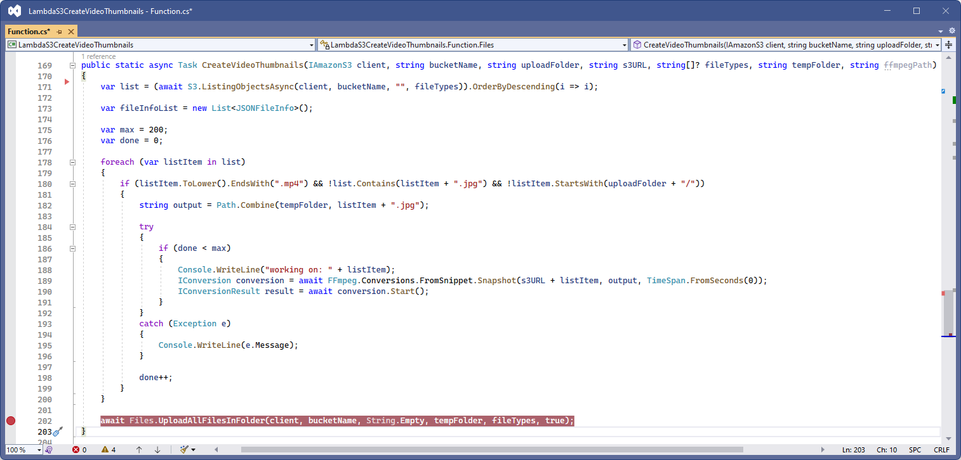
Video thumbnails

Slide 32
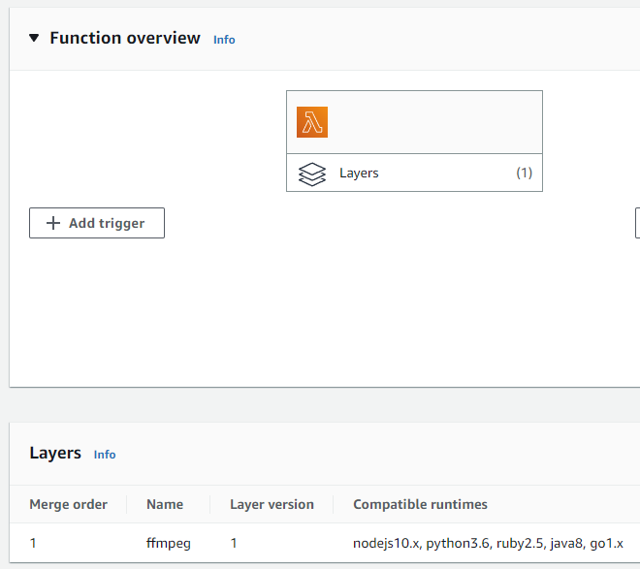
Running FFmpeg on Linux
Functionality ran great on Windows, with local FFmpeg app installed
But what about in AWS Lambda?
AWS solution, using Lambda Layers
- Layer offering ‘ffmpeg-lambda-layer’
Deploy this to your environment, then add this to your function

Slide 33
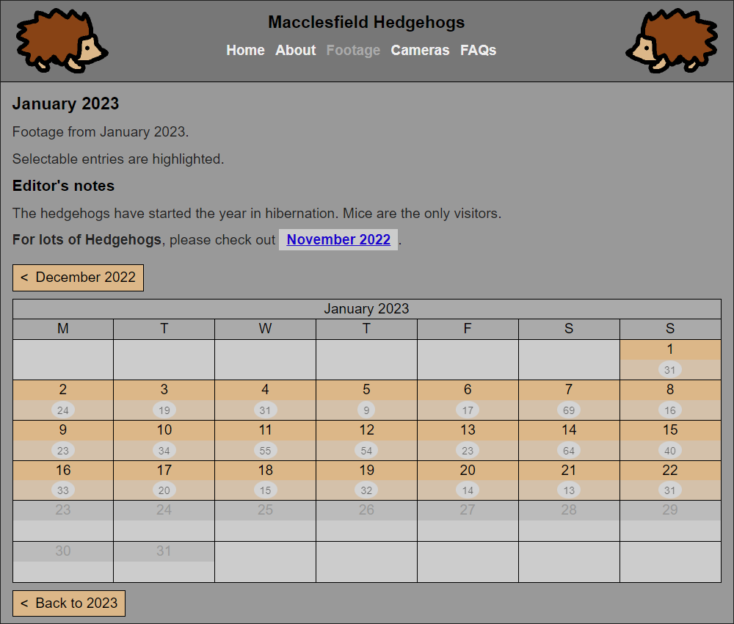
Website alterations
Incorporated thumbnail images
Cosmetic improvements
Mobile specific improvements
Editor’s notes added (per month)
FAQs page added

Slide 34
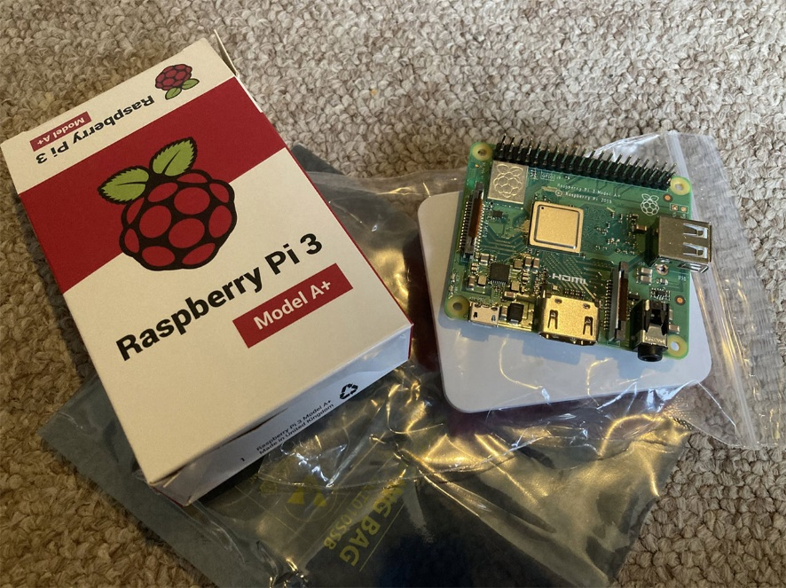
Raspberry Pi
Always in my plan.. but..
- International Shortage of devices
.NET 6 or 7 can run on a 64-bit Linux OS,
- Raspberry Pi 3, 4 or Zero 2 W.
Raspberry Pi 3 - Model A+ ordered
- Cost, with a case, £36.90 inc P+P
- added my own SD Card, HDMI, USB power

Slide 35
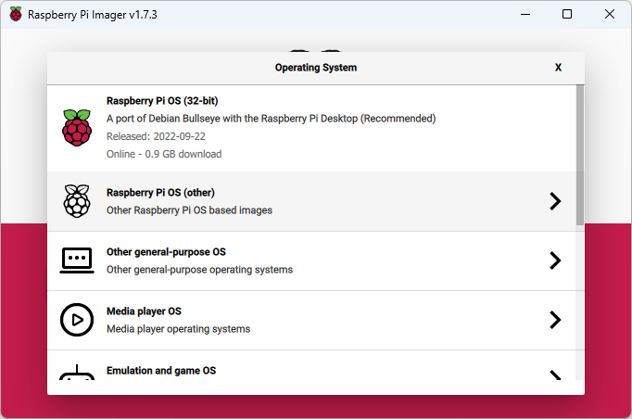
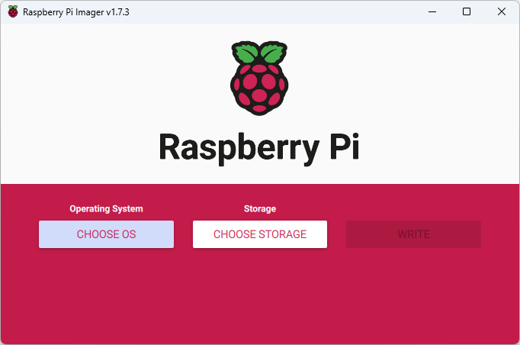
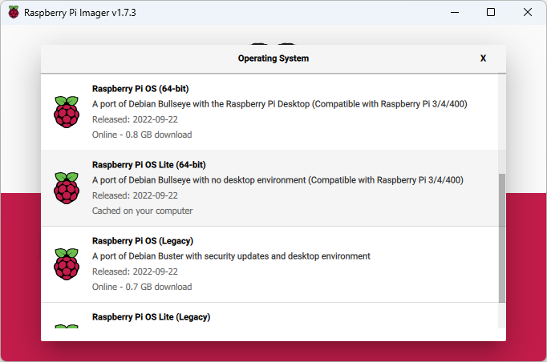
Linux - install
’Raspberry Pi OS Lite’ OS, 64-bit
- based on Debian, no Desktop GUI.
Installed with ’Raspberry Pi Imager’ app
- available for Windows, macOS or Linux
https://www.raspberrypi.com/software/

Slide 36
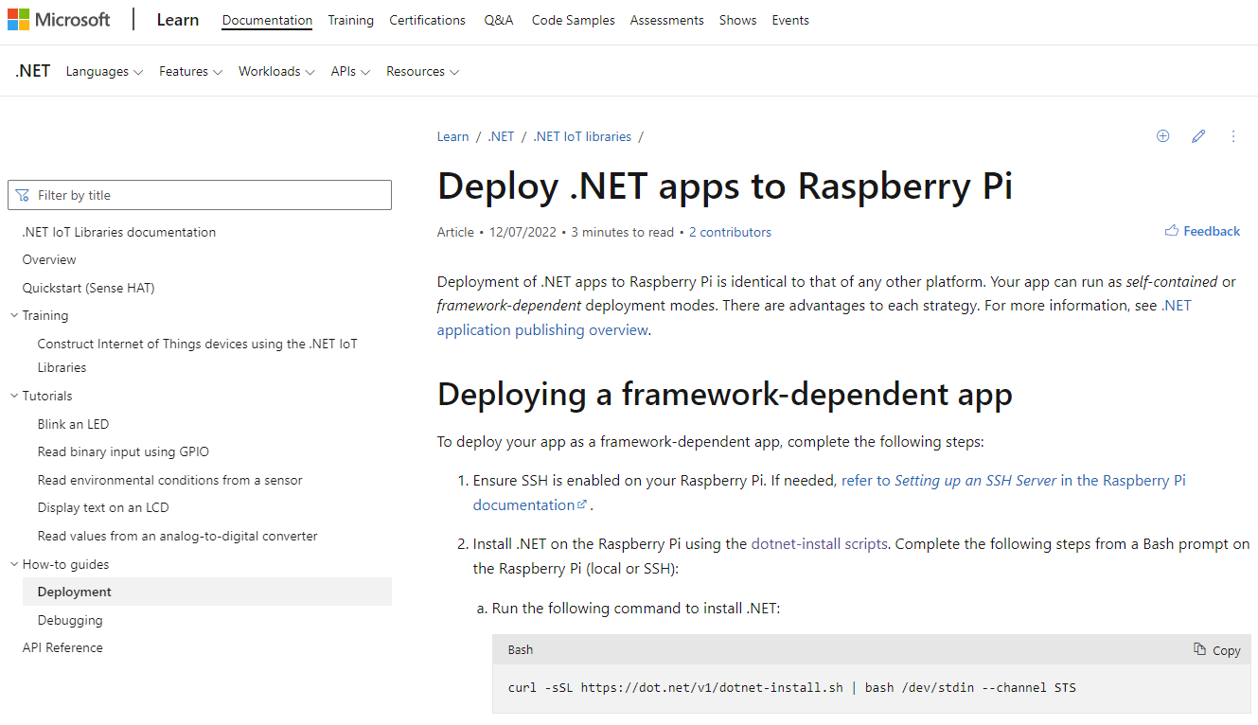
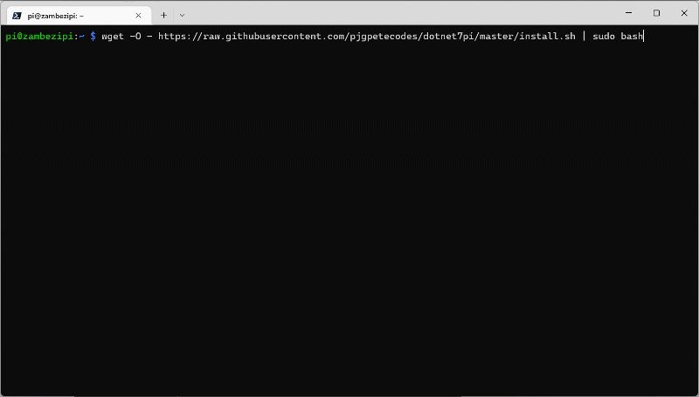
.NET on Linux
Framework-dependent apps
- Install .NET
- STS (.NET 7) or LTS (.NET 6)
Official Docs: https://learn.microsoft.com/en-us/dotnet/iot/deployment
‘1 line install’ from Pete Gallagher - twitter.com/pete_codes https://github.com/pjgpetecodes/dotnet7pi

Slide 37
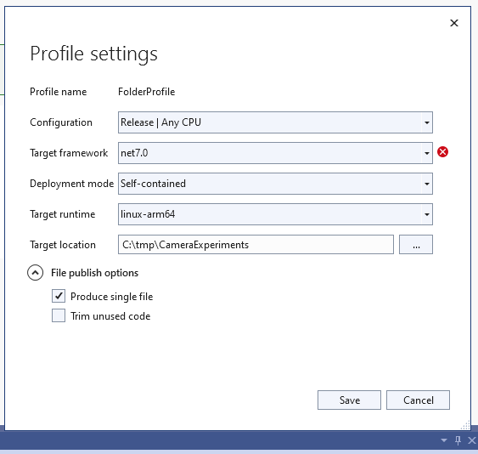
.NET on Linux
Self-contained apps
Publish via Command Line dotnet publish --runtime linux-arm64 --self-contained
Publish Profile in Visual Studio
Deploy: scp -r C:\tmp\CameraExperiments administrator@raspberrypi:/home/administrator/programs/

Slide 38
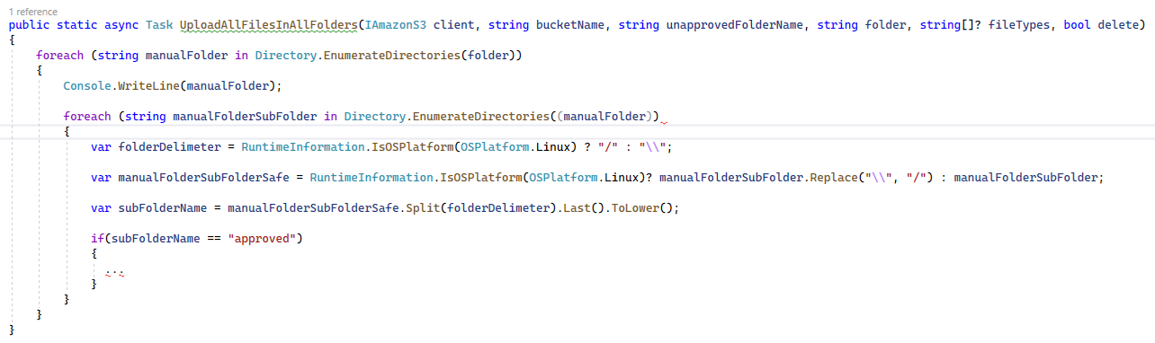
.NET on Linux – code changes
S3 Bucket Experiments app
- very little to change
- Linux file paths and formats

Slide 39
.NET on Linux – code changes
Camera Experiments app
- lots to change
Wi-Fi and Bluetooth
- NuGet Packages not compatible with Linux
- SimpleWifi.netstandard and InTheHand.BluetoothLE
- Instead, calling out to Linux CLI commands in Processes

Slide 40
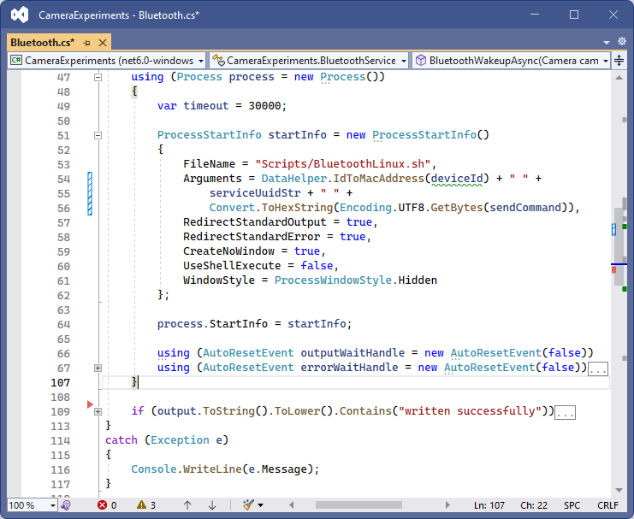
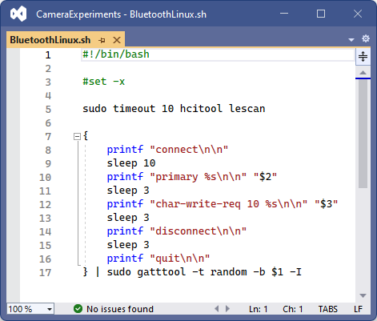
.NET on Linux - Processes

Slide 41
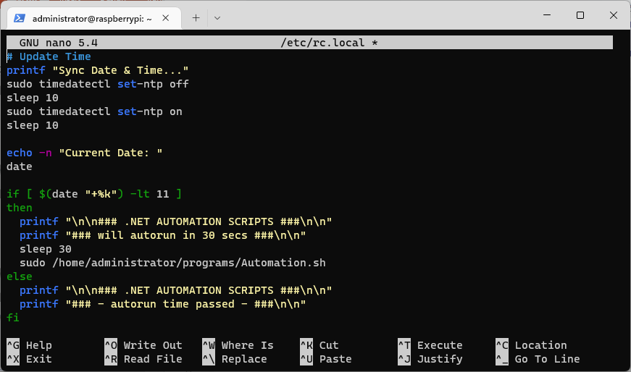
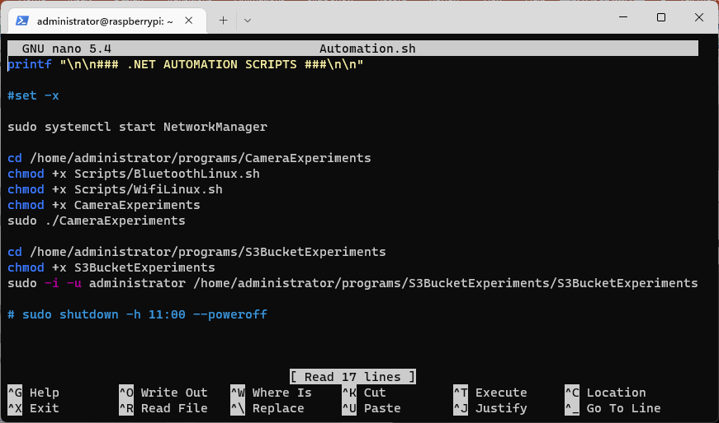
Automation
Run things automatically on boot of the Raspberry Pi

Slide 42
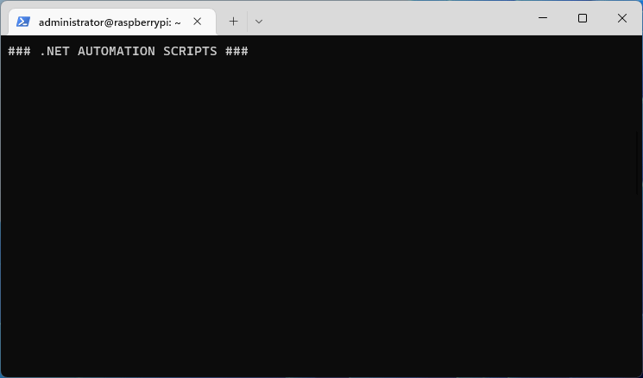
Automation
Example output (sequence shortened)

Slide 43
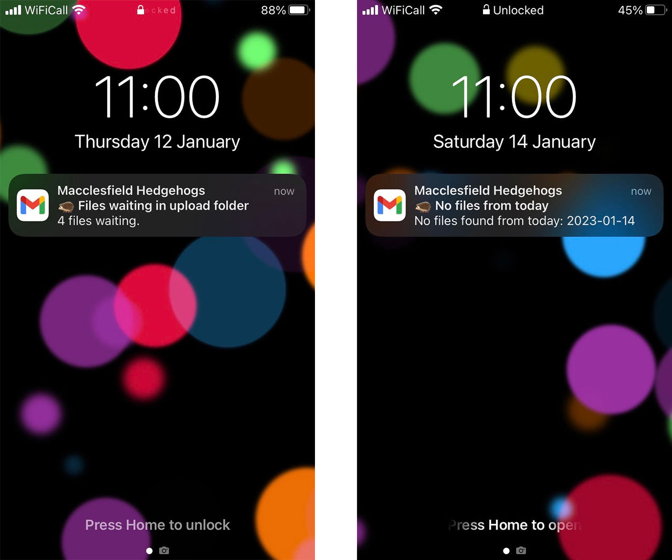
Alerts
Another AWS Lambda Function
Draws on the S3 Bucket Experiments code
Sends email if no new footage, or footage left in Upload folder
Runs at 11am each day

Slide 44
Latest developments
Toshiba FlashAir SD Cards
Improved outdoor setup
Motion detection
Image recognition

Slide 45
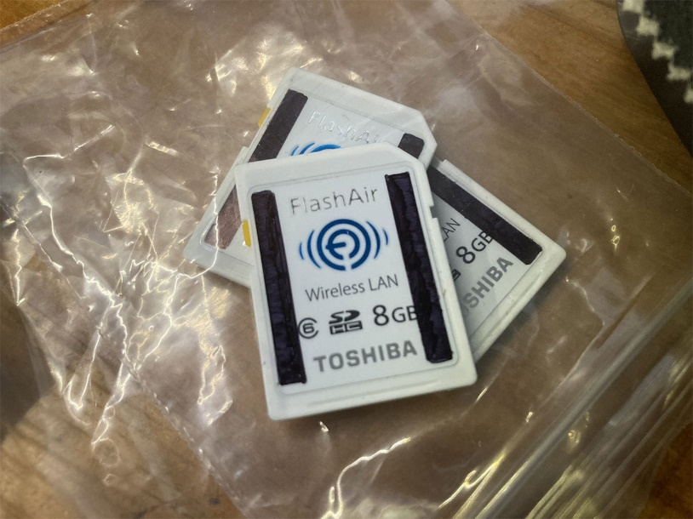
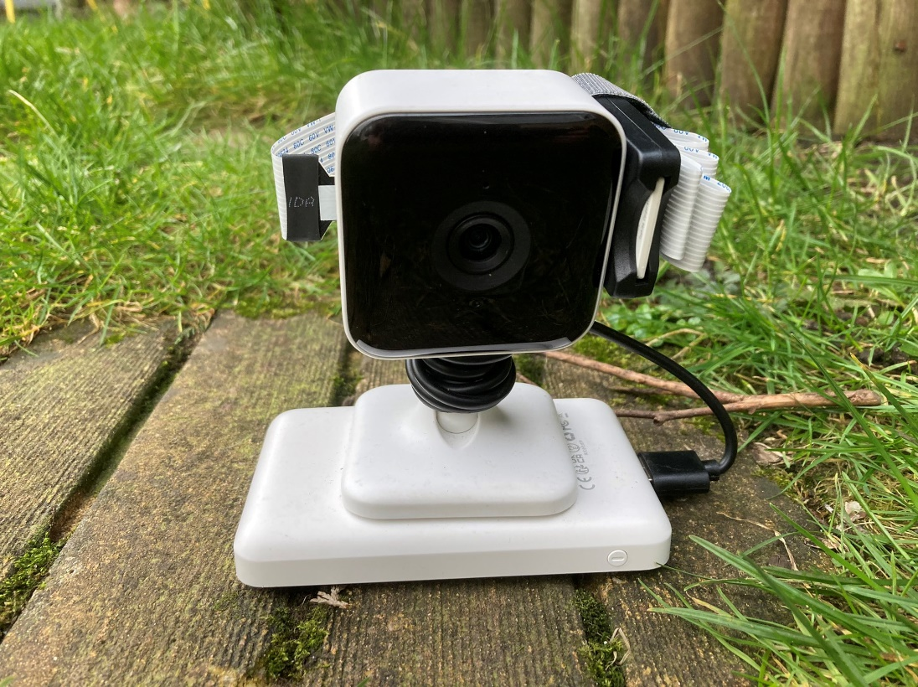
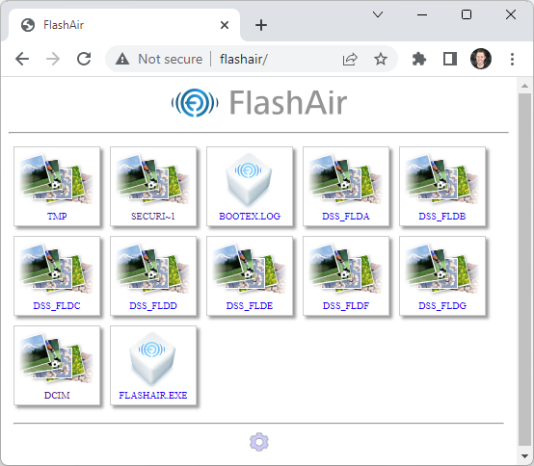

Toshiba FlashAir
SD Cards with built-in Wi-Fi
- can wireless-enable any camera / device
- Micro-SD devices with ribbon cable adapter
- built in Web Server
- CSV file list available via special URL
Altered CameraExperiments project to be able to connect any FlashAir device
- specifying SSID, Password and Folder file containing files

Slide 46


Improved outdoor setup
All cameras now in place
- Xega RBX-S50 replacing the Arlo
- timer switches (SONOFF Smart USB Timers)
- running off a central battery
- charged via a small solar panel
and indoors.. - Raspberry Pi now on a timer

Slide 47

Motion detection
- Xbro XC-100 camera footage only
- Comparing first frame with last frame
- Gaussian blur image, with ImageSharp
- reduce size to 16x16 pixels
- Comparison done with ImageSharpCompare
- % difference reported
- if under a certain percentage, discard
- if over that percentage, approve
Runs in the Video Thumbnail Creation Lambda function

Slide 48

Image recognition
Using Amazon Rekognition
- better for smaller video clips (or images)
- produces a list of matched objects
- and a % likelihood
- can provide a list to look for, and a min %
- running via another AWS Lambda function, directly accessing the S3 Video Clips
- Ceyomur and Xega camera footage
Auto approving ‘hedgehog’ phrases, auto discarding ‘cat’, everything else manual

Slide 49
Amazon Rekognition pricing + demo
Pricing
- Free Tier: 1,000 free minutes of video analysis per month
- Label Detection: $0.10/min
Seems to take roughly 2-3x the video length to analyse (1080p clips)
Demo
- with images
aws.amazon.com/rekognition

Slide 50


Slide 51


The Return of the Hedgehogs!
Hibernation ended on 6th March
Throughout March and April they visited a lot
Less appearances as summer set in
No visits on extreme heat days
Some ‘Daylight’ visits

Slide 52

App - Coming Soon
Work underway on Desktop and Mobile App
Coding in Uno Platform
Some C# Code Reused
Website functionality heavily cloned
Website structure adjusted to provide some content
Targeting iOS, Android, macOS and Windows
App Store, Google Play, Windows Store + Amazon Appstore

Slide 53


Mini screen added
ST7735 series 1.44” TFT Screen
C# / .NET 7, ImageSharp
Shows progress or Debug mode

Slide 54


Thank you
Macclesfield Hedgehogs - https://www.macclesfieldhedgehogs.co.uk/
Slides available on GitHub at https://github.com/mikeirvingweb/dotnet-iot-and-hedgehogs
- All links and references in the README.md file
For more info, find / contact me at:
Twitter - https://twitter.com/mikeirvingweb
LinkedIn - https://www.linkedin.com/in/mikeirving
GitHub - https://github.com/mikeirvingweb
Stack Overflow - https://stackoverflow.com/users/482901/mike-irving
Website & Blog - https://www.mike-irving.co.uk/

Slide 55
Any questions?

Slide 56
.NET, IoT and Hedgehogs!
Mike Irving
dotnetsheff – 1st August 2023
@mikeirvingweb

